Slide 1

EDA ON REPAYING THE CREDIT
by Aparna Padmakumar

Slide 2
Gold Anlantis: Repaying the Credit
Gold Atlantis a credit-providing firm, observed a rise in the number of defaulters. Now the firm is only interested in those clients who have a lower probability of becoming a defaulter.
The aim of this analysis is to help the firm identify those customers who have a lower probability of becoming a defaulter.

Slide 3
EXPLORATORY DATA ANALYSIS
EDA is a crucial step in the data analysis that involves exploring and understanting the structure, patterns, and charecteristics of a dataset to answer key business questions.
Steps in EDA
Level 0: Data collection and Understanding
Level 1: Univariate Analysis
Level 2: Bivariate Analysis
Level 3: Multivariate Analysis
Level 0 involves collecting the relevant dataset and understanding its structure, variables to establish a foundation for further analysis
Level 1 focuses on analyzing individual variables in the dataset and visualizing the data to understand their distribution and pattern.
Level 2 explores the relationship between two variables in the dataset to identify dependencies, associations or correlations.
Level 3 involves analyzing the relationship between three or more variables to uncover complex patterns, dependencies and underlying structures within the data

Slide 4
UNDERSTANDING DATA
The dataset has 100000 rows and 24 columns
Categorical columns
Target
Name_contract_type
Gender
Car
House
Cnt_children
Name_type_suite
Name_education_type
Name_family_status
Mobile
Work_phone
Home_phone
Mobile_reachable
Flag_email
Occupation_type
Cnt_fam_members
Application_day
Total_doc_submitted
Continuous columns
Sk_id_curr
Amt_income_total
Amt_credit
Amt_goods_price
Days_employed

Slide 5
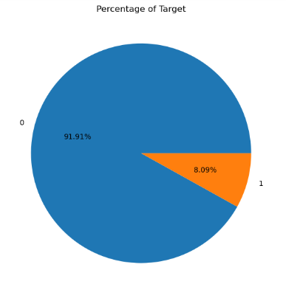
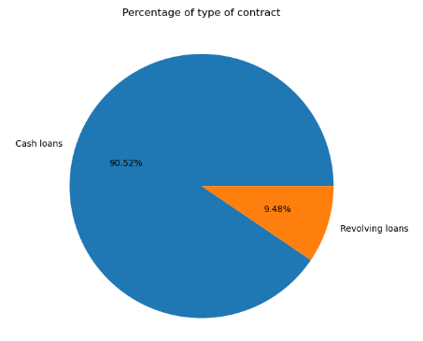
Univariate analysis of categorical columns
Interpretation:
Fig 1 shows that there are 8.09% customers who have payment difficulties. So we can say that these clients have a higher probability of becoming defaulters.
Fig 2 suggests that there are 90.52% clients whose contract type is cash loans.

Slide 6
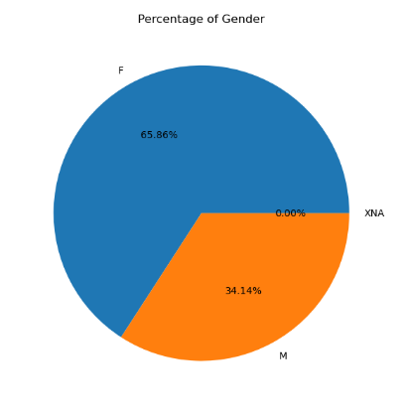
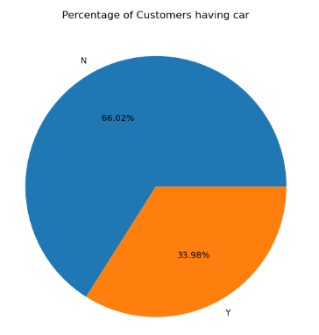
Interpretation:
In Fig 1 Shows the percentage of gender of clients.
Female clients are more in number, contributing to 65.86%
Fig 2 shows the percentage of customers having car.
Above graph suggests that Clients having no car is more in number, contributing to 66.02%.

Slide 7
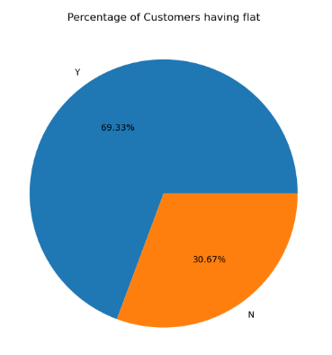
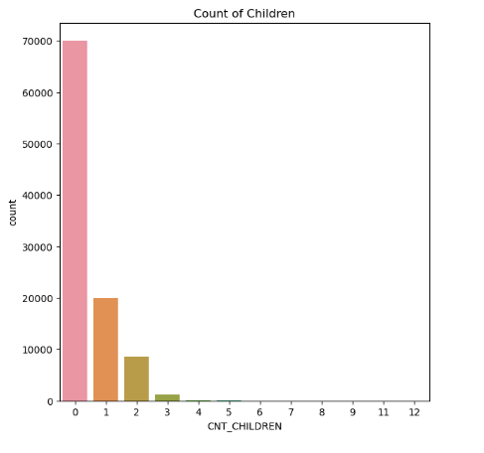
Interpretation:
Fig 1 shows the percentage of customers having flat
The graph suggest that Majority of clients owns a flat, contributing to 69.33%.
Fig 2 shows the count of customers having children
Above graph shows that Majority of clients have no children.

Slide 8
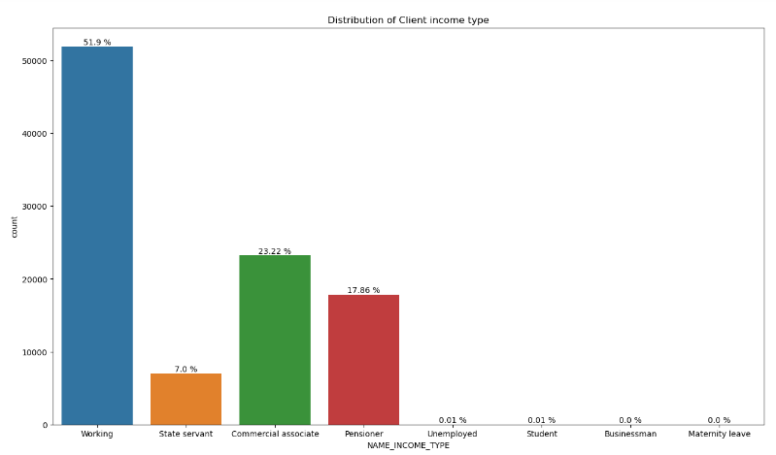
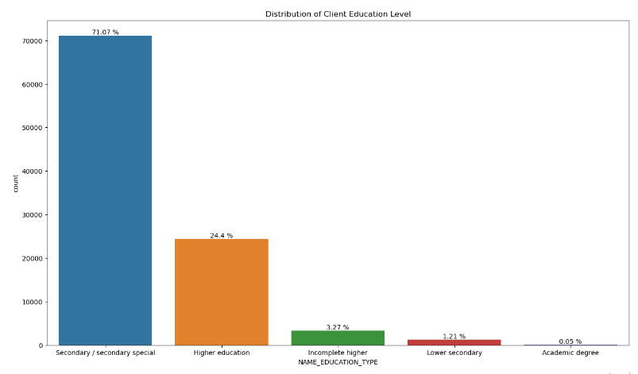
Interpretation:
Fig 1 shows the distribution of client income type. This observation suggest that majority of clients have income type as working.
Fig 2 shows the distribution of client education level. Above graph suggest that most client have their education level as secondary/secondary special.

Slide 9
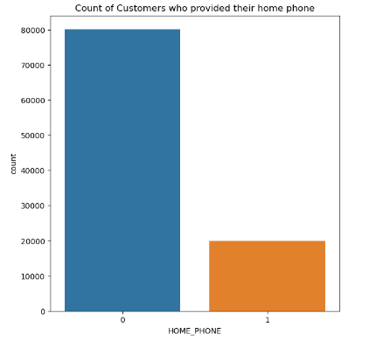
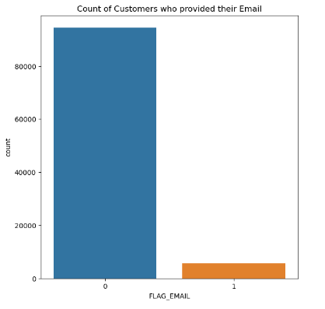
Interpretation:
Fig 1 shows the count of clients who have provided their home phone number. As per the above graph in can be concluded that majority of clients have not provided their phone number.
Fig 2 shows the count of clients who have provided their email id. The above observation suggests that majority of clients have not provided their email.

Slide 10
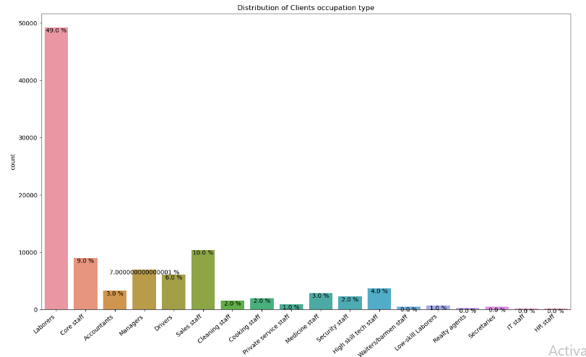
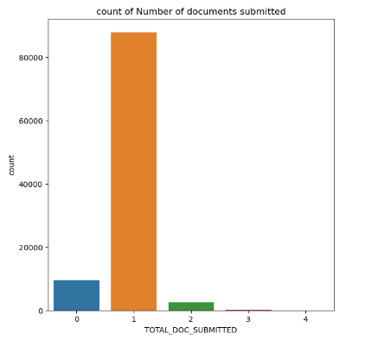
Interpretation:
Fig 1 shows the distribution of clients occupation type. As per the graph Majority of clients Occupation type is Laborers, contributing to 49.0%.
Fig 2 shows the count of number of documents submitted by client. As we can see in the graph Majority of clients submitted 1 document.

Slide 11
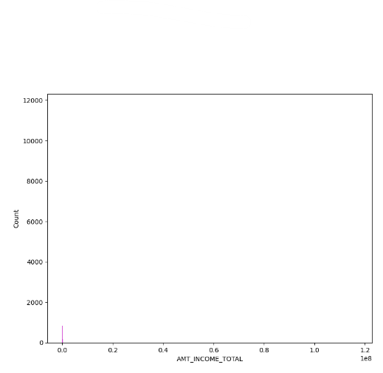
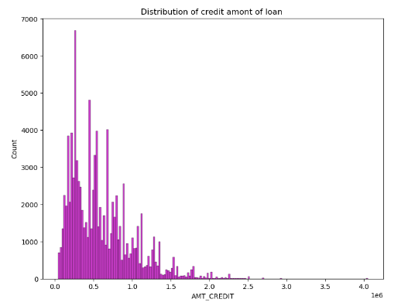
Interpretation:
Fig 1 shows the distribution of total income amount of clients.
Fig 2 shows the distribution of credit amount of loan.
As we can see there are outliers in both the data we need to remove these outlier and clean the data

Slide 12
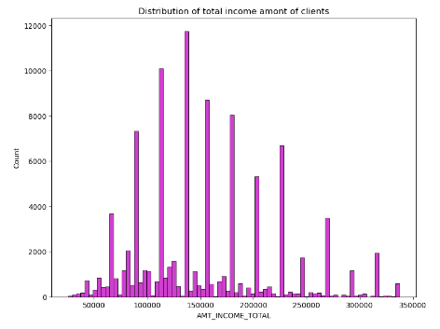
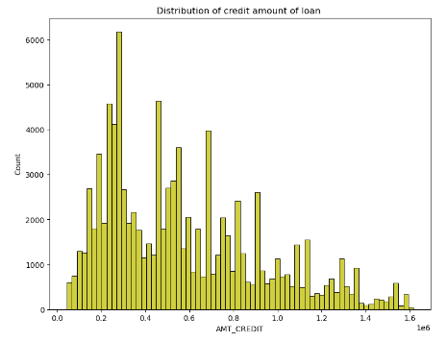
Univariate analysis of continuous columns
Interpretation:
Fig 1 shows the distribution of total income amount of clients. By seeing the above graph we can conclude that majority of clients have a total income ranges from 100000 to 150000.
Fig 2 shows the distribution of credit amount of loan.

Slide 13
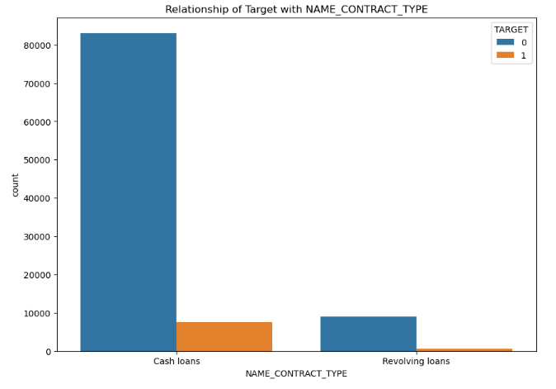
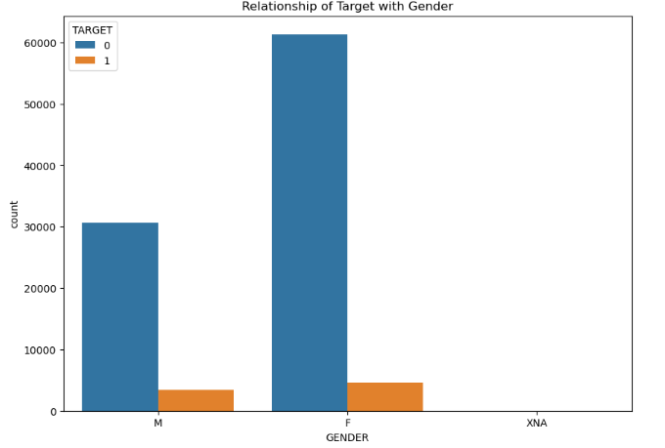
Level 2 : Bi-Variate Analysis
Interpretation: By observing the above graph it is seen that in the category cash loan the number of clients with payment difficulties is more as compared to Revolving loans.
This observation suggests that clients with cash lone may have higher likelihood to be a defaulter
Interpretation: By observing the above graph it is seen that Female clients with payment difficulties is more as compared to Revolving loans.
This observation suggests that Female clients may have higher likelihood to be a defaulter

Slide 14
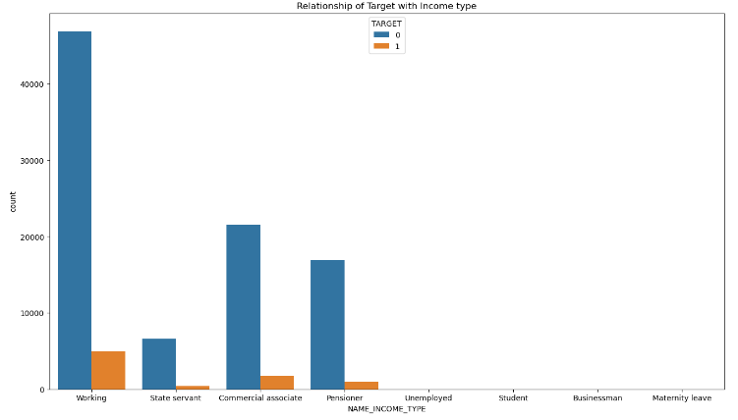
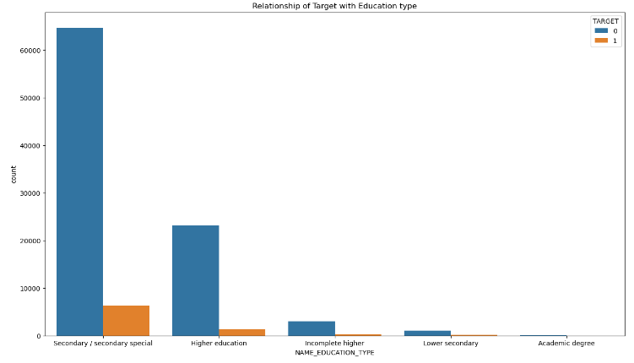
Interpretation: By observing the above graph it is seen that among clients who have 'working' as their income type have more number of clients with payment difficulties.
This observation suggests that clients with income type 'working' may have higher likelihood to be a defaulter.
Interpretation: As we can see in above graph clients with Secondary/secondary special education type has more number of people with payment difficulties.
This observation suggests that clients with secondary education have more liklihood to be a defaulter

Slide 15
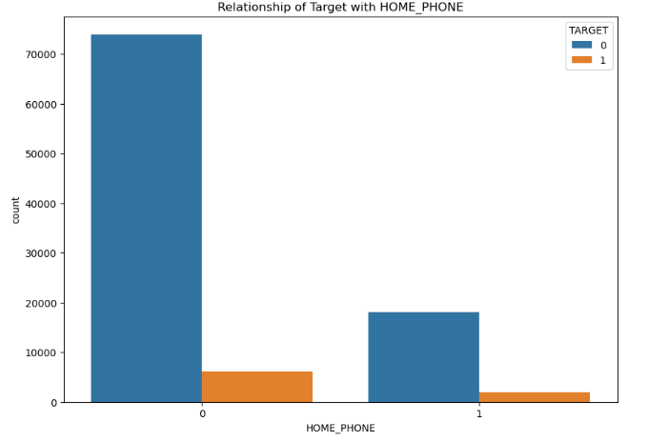
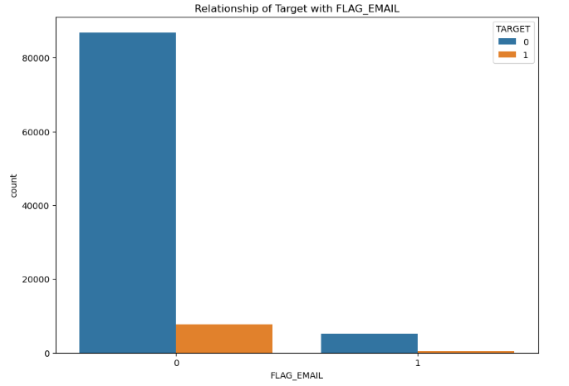
Interpretation: As we can see in above graph clients with Secondary/secondary special education type has more number of people with payment difficulties.
This observation suggests that clients with secondary education have more liklihood to be a defaulter
Interpretation: By observing the above graph we can see that among clients who haven't provided their email has more number of clients with payment difficulties.
This observation suggest that clients who have not provided their email is more loklihood to be a defaulter

Slide 16
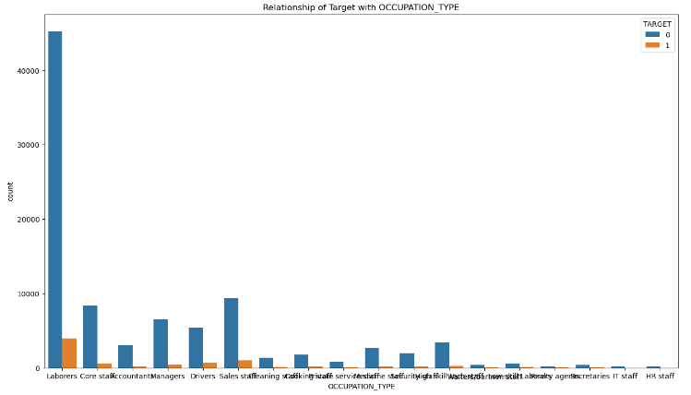
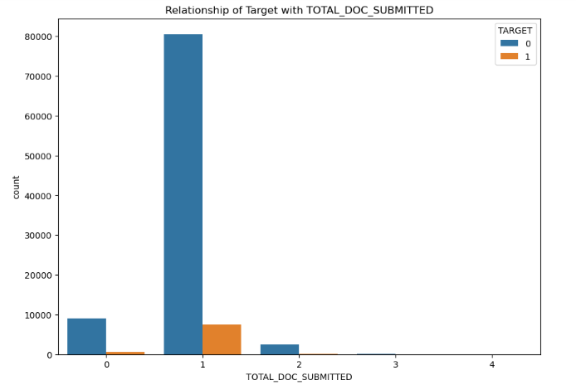
Interpretation: By observing the above graph it is evident that clients whose occupation type is Laborers have more payment difficulty than others.
This observation suggest that client having occupation type as Laborers have more likelihood to be a defaulter.
Interpretation: By observing the above graph it is seen that clients who have submitted only 1 document have more payment difficulties.
This observation suggest that client who have submitted only 1 document have more likelihood to be a defaulter.

Slide 17
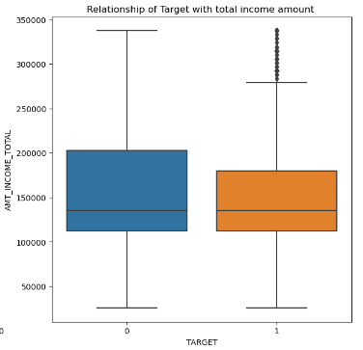
CAT NUM ANALYSIS: Categorical to continuous
Interpretation: As per the above graph client who have total income between 100000 and 200000 have payment difficulty.
This observation shows that clients having total income ranges from 100000 to 200000 have most likelihood to be a defaulter.

Slide 18
CONCLUSION
Based on the analysis, it can be concluded that clients with cash loans, females, working individuals, laborers, clients who have submitted only one document and client whose total income salary ranges between 100000 and 200000 have a higher likelihood of becoming defaulters.
To identify customers with a lower probability of defaulting, Gold Atlantis should carefully evaluate these factors.
By considering these patterns the firm can mitigate the risk of defaults and make informed decisions during loan approval process

Slide 19
THANKYOU

